Slide 1
Statistical Methods for Genomics Part 2: Testing for association with rare variants

Slide 2
Common vs. rare variants
GWAS are concerned with common variants (MAF at least 5%)
Rare variants have MAF less than 5% and most times much smaller
De novo variation: only occurs in offspring and not in parents
Each individual carries a number of unique (de novo) mutations (not seen before)
The vast majority of genetic variants in the human genome are rare.

Slide 3
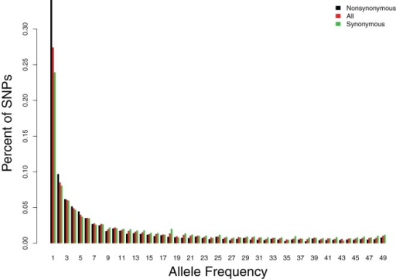
Site Frequency Spectrum

Slide 4
Sequencing technologies identify rare variants
Only sequencing can identify such rare variants
Recent technological advancements have led to the ability to sequence in a cost effective manner a large number of individuals
E.g. 1000 Genomes Project www.1000genomes.org/‎
NHLBI ESP: “discover novel genes and mechanisms contributing to heart, lung and blood disorders by pioneering the application of next-generation sequencing of the protein coding regions of the human genome across diverse, richly-phenotyped populations and to share these datasets and findings with the scientific community to extend and enrich the diagnosis, management and treatment of heart, lung and blood disorders.”
ExAC – Exome Aggregation Consortium
``The Exome Aggregation Consortium (ExAC) is a coalition of investigators seeking to aggregate and harmonize exome sequencing data from a wide variety of large-scale sequencing projects, and to make summary data available for the wider scientific community. “
ExAC contains genetic variation from 60,706 unrelated individuals that are part of various sequencing projects.

Slide 5
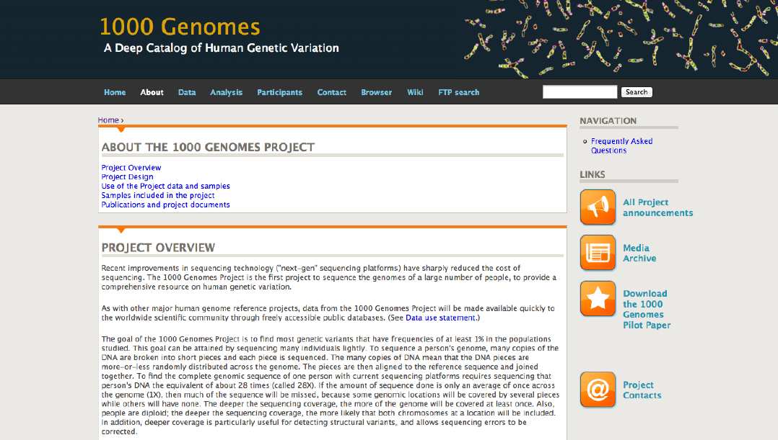
b

Slide 6
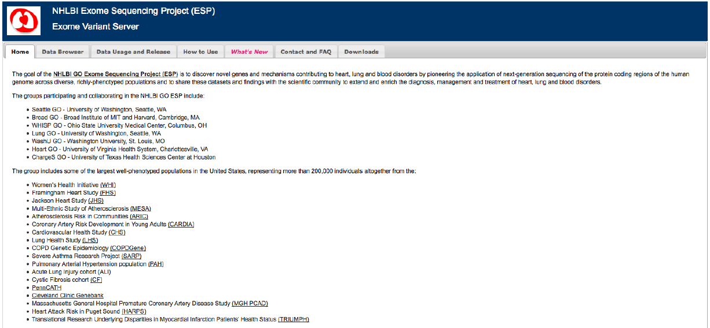
n

Slide 7
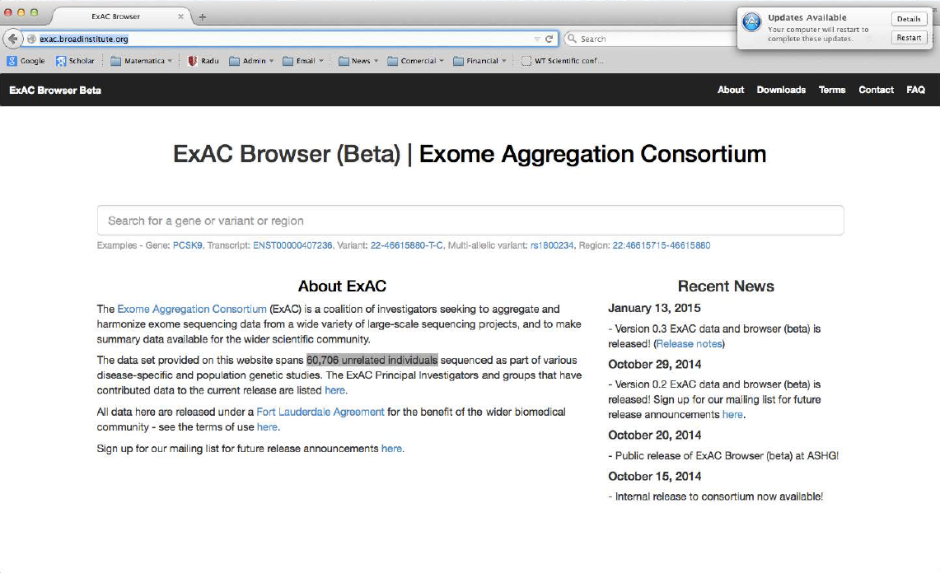

Slide 8
Next-generation sequencing
Platforms: ABI SOLID, Solexa - Illumina, Roche 454, Third Generation (Pacific Biosciences, Complete Genomics)
Pipelines are being developed to go from unmapped short reads to identification of genetic variation.
Exome (about 1% of the genome) vs. whole genome
Whole-Exome-Sequencing (WES) is a cost efficient manner to survey variation in the coding regions of the genes
Whole-Genome-Sequencing (WGS) is becoming increasingly feasible

Slide 9
From short reads to genetic variants
Raw short reads
Mapping and alignment
Solexa
Region 1
Region 2
SOLiD
Human reference genome
454
A single run of a sequencer generates ~50M ~75bp short reads for analysis
The origin of each read from the human genome sequence is found
Quality calibration and annotation
Identifying genetic variation
Region 1
Region 2
Region 1
Region 2
Human reference genome
Human reference genome
SNP
The quality of each read is calibrated and additional information annotated for downstream analyses
SNPs and indels from the reference are found where the reads collectively provide evidence of a variant

Slide 10
Statistical Methods to test for association with rare variants
Issues when testing with rare variants:
- low frequency (less than 0.01), so few occurrences of the variant in reasonable datasets
- many rare variants: therefore increased penalty for multiple testing (over 95% of variants in a region have MAF<1%)
- effect sizes are not expected to be very large (OR ~ 4.5)
Traditional association testing, as used for common markers, such as the CA trend test has very low power for rare variants.
Need for powerful statistical methods.

Slide 11
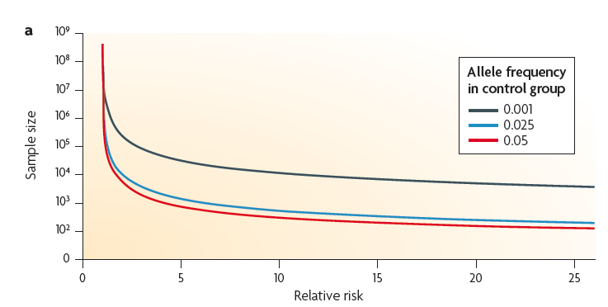
Sample sizes needed to identify associations with rare variants

Slide 12
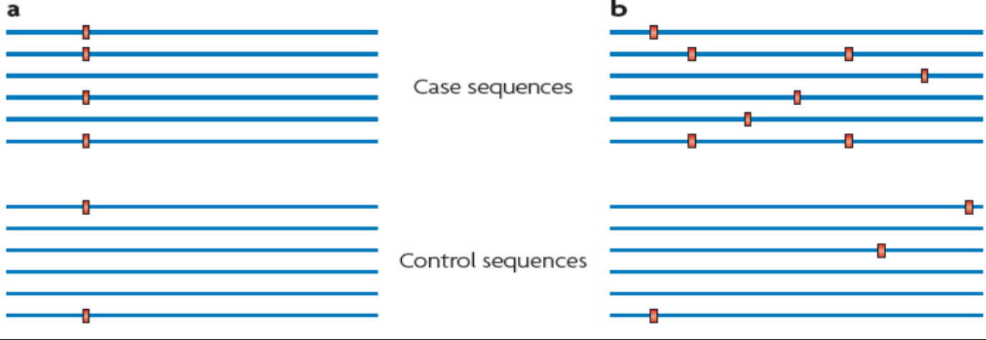
COMMON vs. RARE variant Scenario

Slide 13
Strategies for rare variant analysis
Collapsing: group variants in a region/gene
Weighting: weight variants depending on predicted functional effect
Predicted deleteriousness effect for coding variants: is a variant damaging - PolyPhen and SIFT, is a variant evolutionarily conserved (GERP, PhastCon, PhyloP)
For noncoding variants we have large-scale genomic projects such as the Encyclopedia of DNA Elements (ENCODE), Ensembl and Roadmap Epigenomics for genomic element annotation.
For noncoding variation: does the variant fall in a predicted regulatory element? Is the variant an eQTL (expression quantitative trait locus)?
Variants that are predicted to be deleterious, or fall in regulatory elements are apriori more likely to be involved in disease

Slide 14
PolyPhen-2
Prediction of functional effects of human nsSNPs
``PolyPhen-2 (Polymorphism Phenotyping v2) is a tool which predicts possible impact of an amino acid substitution on the structure and function of a human protein using straightforward physical and comparative considerations.”
PolyPhen provided for each nsSNP a number between 0 and 1 (the probability to be damaging).

Slide 15
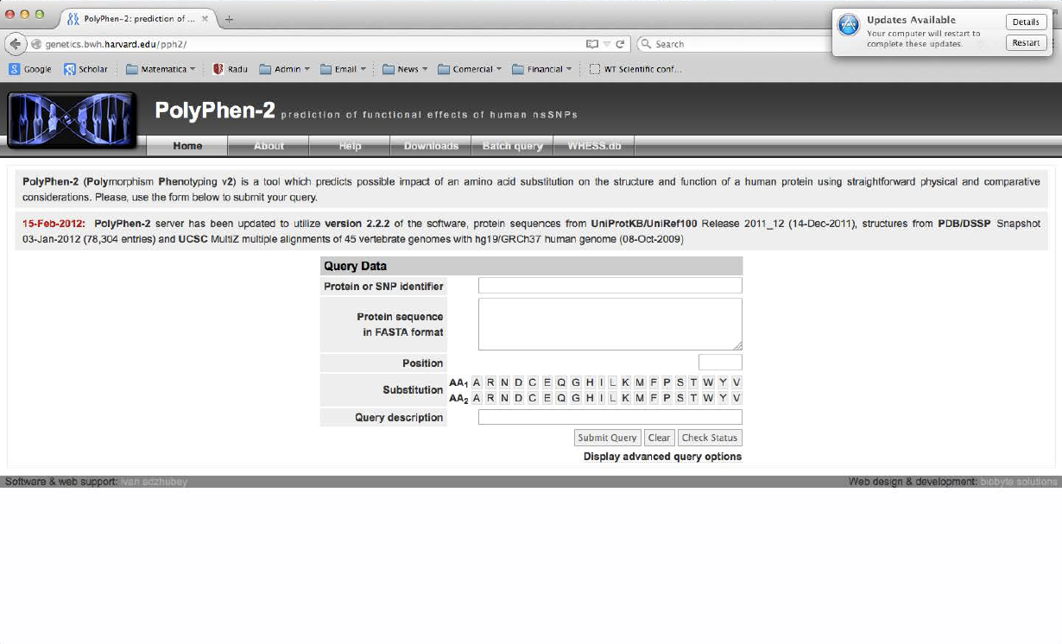

Slide 16
GERP
GERP=Genomic Evolutionary Rate Profiling
``GERP identifies constrained elements in multiple alignments by quantifying substitution deficits. These deficits represent substitutions that would have occurred if the element were neutral DNA, but did not occur because the element has been under functional constraint.’’

Slide 17
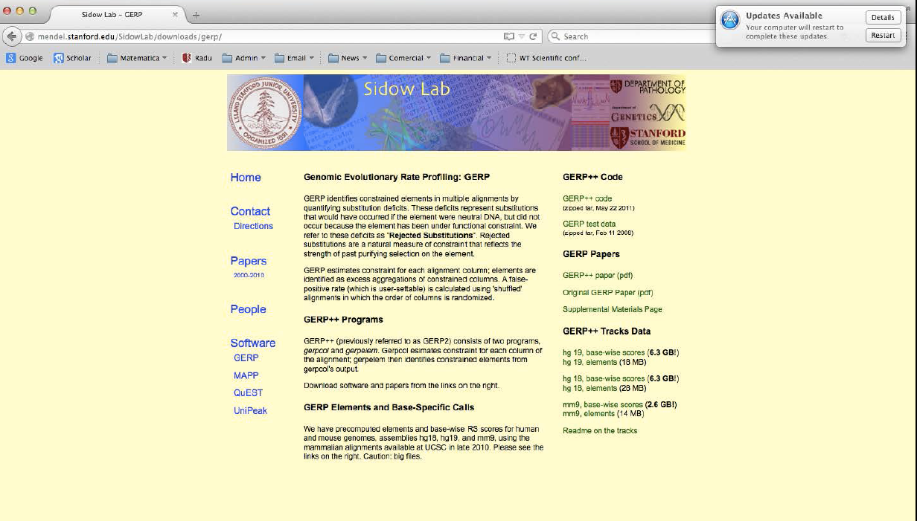

Slide 18
ENCODE
The Encyclopedia of DNA Elements (ENCODE) is a public research project launched by the US National Human Genome Research Institute (NHGRI) in September 2003 as a follow-up to the Human Genome Project
The ENCODE project aims to identify all functional elements in the human genome.
In particular, it aims to identify all regulatory elements in the human genome
This functional annotation of the human genome is very important for identifying the causal variants in a region of interest (e.g. in a GWAS region)

Slide 19
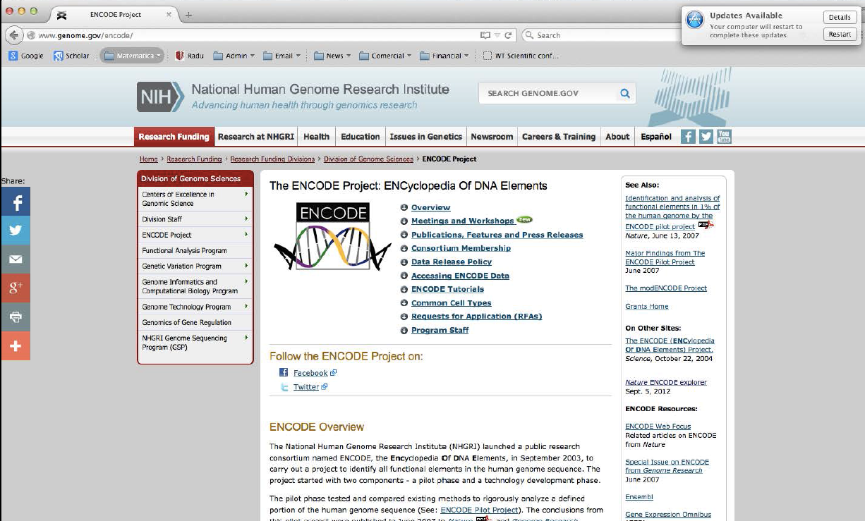

Slide 20
Group-wise association tests
We assume n subjects have been sequenced in a region with m variants
Potentially many rare variants among the m variants
We want to test the null hypothesis that none of the m variants is associated with the disease
Standard testing strategies (marginal, multi marker multi-df) have low power

Slide 21
Two types of disease associated variants
Risk variants: increase risk to disease, hence their frequency tends to be higher among cases compared with controls.
Protective variants: decrease risk to disease, hence their frequency tends to be higher among controls compared with cases.

Slide 22
Collapsing Method
Each individual in the study is or is not a carrier of rare variant.
Test whether the proportion of carriers of rare variants is different in cases vs. controls using Fisher’s exact test.
This approach is simple, but has several weaknesses: does not weigh variants, reduced power when the region is large, sensitive to mixture of risk and protective variants
 | Carrier | Non-carrier
Case | a | b
Control | c | d

Slide 23
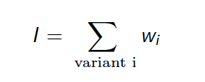
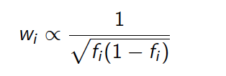
Weighted-Sums
For each individual a score is calculated: weighted-sum of variants present in the individual is calculated.
The weight for each variant w_i is calculated as:

Slide 24
Weighted-Sums
Additionally weights can be replaced by predictions on a variant being functional, as from PolyPhen-2 and GERP
Then test whether the distribution of weighted-sum scores in cases is different from the corresponding distribution in controls.
Use a non-parametric test, such as Kolmogorov-Smirnov test.
Better than collapsing, but still reduced power when mixture of risk and protective variants.

Slide 25
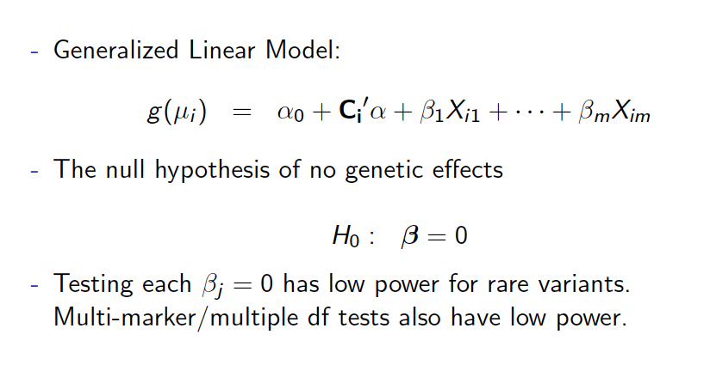
Association tests for sequencing data
n

Slide 26
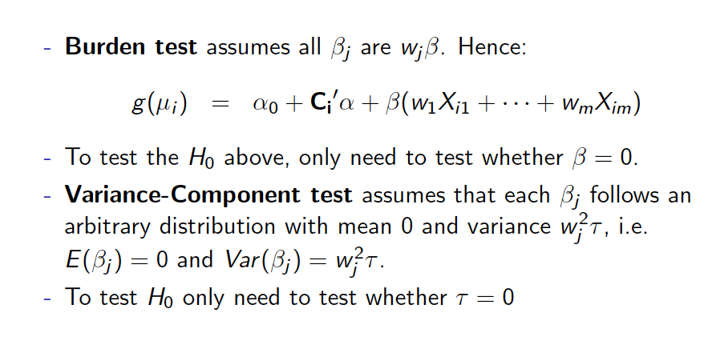
Burden vs. Variance-Component tests

Slide 27
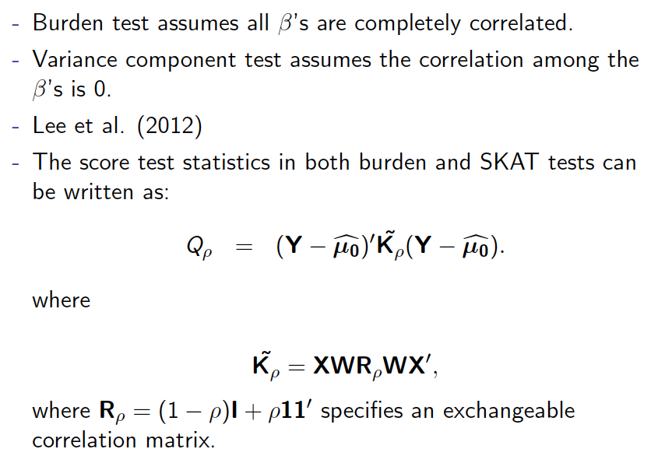
n

Slide 28
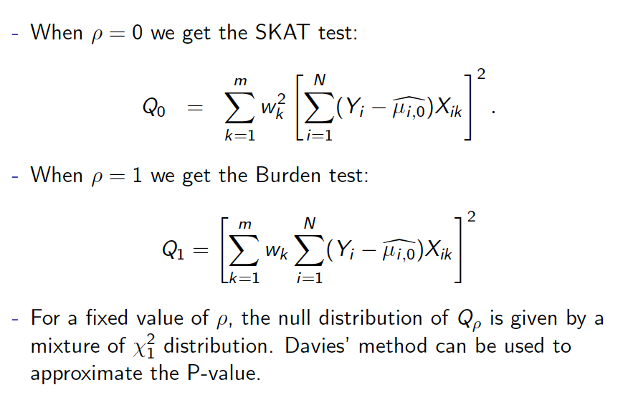
n

Slide 29
SKAT-O
SKAT-O is an omnibus test
It optimizes over both the Burden and SKAT tests
When p=0, SKAT-O=SKAT
When p=1, SKAT-O=Burden
Calculates the p-value for SKAT-O
SKAT-O is a good choice for association testing with sequencing data when we are not sure whether Burden or SKAT would be better (this is usually the case).

Slide 30
SKAT-CommonRare
The current SKAT test gives almost zero weight to common variants
However it is possible that both rare and common variants in a disease gene can influence risk to disease.
Therefore SKAT-CommonRare is a test that combines two separate test statistics, one for rare and one for common, this way allowing the common variants to contribute as well to the overall test statistic for a gene

Slide 31
Software
SKAT: http://www.hsph.harvard.edu/skat/
“SKAT is a SNP-set (e.g., a gene or a region) level test for association between a set of rare (or common) variants and dichotomous or quantitative phenotypes, SKAT aggregates individual score test statistics of SNPs in a SNP set and efficiently computes SNP-set level p-values, e.g. a gene or a region level p-value, while adjusting for covariates, such as principal components to account for population stratification. SKAT also allows for power/sample size calculations for designing for sequence association studies.”

Slide 32
Two special scenarios
1. Finding genes in Mendelian Diseases
2. Finding genes using de novo mutations in trio designs

Slide 33
Finding gene for Mendelian disorders using next generation sequencing data
Traditionally genes for Mendelian disorders are identified using classical parametric linkage analysis, followed by fine mapping of the linkage peak. Large pedigrees are needed, and tedious follow-up of the large linked region (several mega bases long) is needed to identify the causal variants in the region.
NGS offers a potentially simpler way to identify genes for Mendelian approaches using a so-called “filtering approach”.

Slide 34
Filtering approach
No need to collect large pedigrees (which can be important for very rare diseases)
The underlying assumption is that the true causal mutations are very rare (e.g. are not present in public databases such as 1000 genomes, NHLBI, ExAC), deleterious (e.g. they are predicted to be damaging by PolyPhen), they are in regions that are evolutionarily constrained, and are fully penetrant. Also all affected individuals are expected to have causal mutations in the same gene.
Applying such a filtering approach can result in the identification of a unique gene
However, even Mendelian diseases are often more complex: e.g. mutations are not fully penetrant, hence mutations can be present in unaffected individuals and hence can be present in public databases of genetic variations.
Oftentimes when researchers apply such a filtering approach for Mendelian diseases, they cannot identify a unique gene.
Caution: such a filtering approach is not appropriate for complex disorders which are polygenic, and disease variants have low penetrance

Slide 35
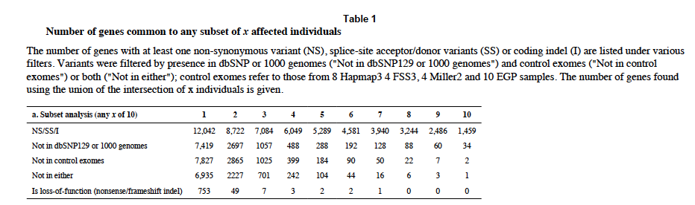
Application of filtering approach to Kabuki Syndrome
Ng et al. Nature Genetics 2010 “Exome sequencing identifies MLL2 mutations as a cause of Kabuki syndrome”

Slide 36
Multiplicity test for de novo mutations
With trio designs (affected child and the two biological parents) it is possible to identify de novo mutations, i.e. mutations present in the child but not in parents.
This is the rarest type of genetic variation
Some of these de novo mutations can be very deleterious as natural selection has not had a chance to act upon them
Several recent whole-exome sequencing studies have identified associations between autism and de novo loss-of-function (LoF) mutations
In particular, several genes have been identified that were found hit by multiple such de novo LoF mutations

Slide 37
Multiplicity test for de novo mutations
The multiplicity is important
Because of the rarity of de novo mutations, it is extremely unlikely that two or more de novo mutations hit the same gene
Roughly speaking, if a gene is hit multiple times by LoF (or even missense) de novo mutations, that is a strong indication that the gene is a disease gene
However, one needs to take into account the gene length (longer genes have higher probability to be hit by de novo mutations than shorter genes), and also the gene context (e.g. GC content: some genes are more mutable than others).

Slide 38
Multiplicity test for de novo mutations
Samocha et al (Nature Genetics 2014) propose a mutational model that helps interpret the observed de novo mutation rate for a gene
This theoretical model predicts the expected amount of de novo variation per gene
Then one can use the Poisson distribution with the expected mutation rate per gene to identify those genes that have significantly more de novo mutations than expected by chance.

Slide 39
Multiplicity test for de novo mutations
Approximately 20,000 genes
For each gene G, let:
O=observed number of de novo mutations for gene G
E=expected number of novo mutations for gene G, as predicted by the Samocha model
Then O~Poisson(E) and we can calculate a p value for gene G

Slide 40
Example of multiplicity test
SETD1A and schizophrenia
In a study with 231 parent-proband case trios, we identified two de novo LOF mutations hitting the same gene, SETD1A
We are interested in assessing the statistical significance of observing two or more de novo LOF mutations for this gene in 231 trios.
We first need to specify the mutation rate for SETD1A.
From Samocha et al., for SETD1A, we obtain an LOF mutation rate per chromosome of 4.75 × 10⁻⁶
Hence in 231 probands we expect 231*2*4.75 × 10⁻⁶=0.0021945 mutations
Then the probability of two or more de novo LOF mutations is 1-ppois(1,0.0021945)=2.404395e-06
Assuming that there are 20,000 genes, the genome-wide p value is 0.048.

Slide 41
TADA
Integrated Model of De Novo and Inherited Genetic Variants to Identify Risk Genes
He et al. PloS Genetics 2013
In addition to de novo variation it also incorporates evidence from inherited variation in trios, and case-control frequencies in case-control studies
For example for an autism sequencing study, we have data on multiple designs: trios, case-control
Hence it uses more information than the simple multiplicity test, and can be more powerful

Slide 42
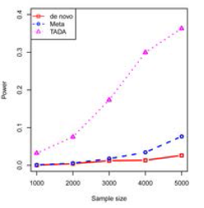
TADA vs. multiplicity test

Slide 43
Further Issues
Sequencing errors
Population stratification
Use of publicly available controls – highly problematic
Genetic regions to analyze - exons only, gene-level, moving window – implications for multiple testing
Imputation – not very good for very rare variants, need large reference panels.
Multiple testing – many possible groups are being tested.
Family-based tests

